Slide 1
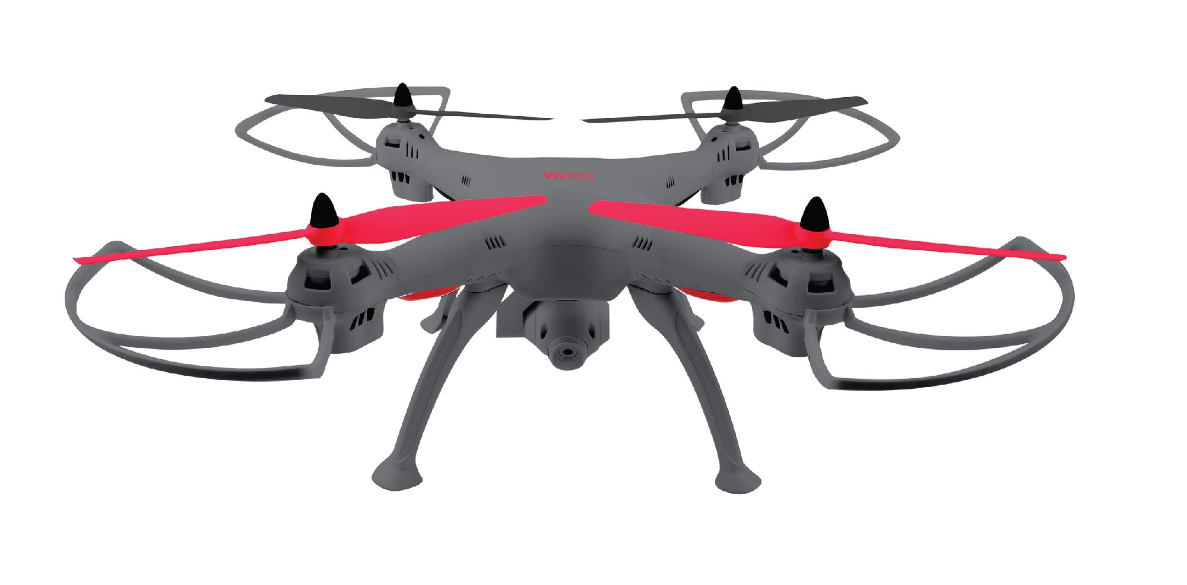
Search and Rescue Assistant
Group 8
Sahana Asokan
Won Seok Chang
Abhishek Chaudhuri
Shantanu Ghosh
Srikrishnaraja Mahadas
Avnish Patel
Sri Sai Krishna Tottempudi
Vishal Venkateswaran

Slide 2
Overview
Purpose:
To cover more area more efficiently and safely without or minimum need of a helicopter or first responders in case of emergency.
Increase the number of lives saved
Decrease the number of lives of first responders lost
Important Features:
Thermal/normal stream
Real-time view
Safe & durable
Easy access
Ready-to-launch
Use Cases:
ViewCamera
GetLocation
CheckObstacles
GetStatus
GetData

Slide 3
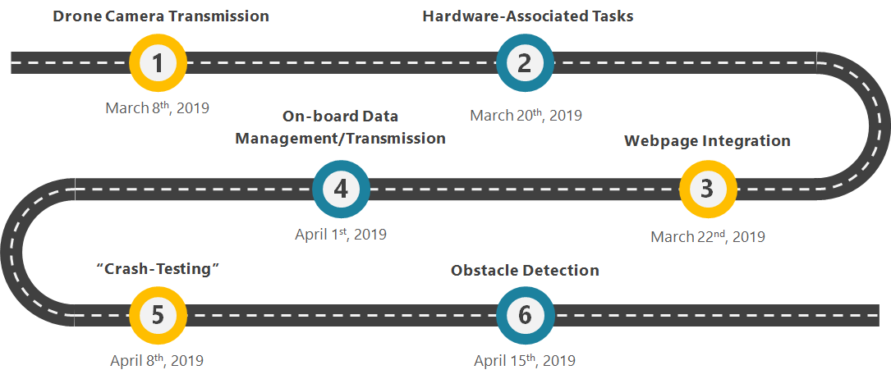

Roadmap

Slide 4
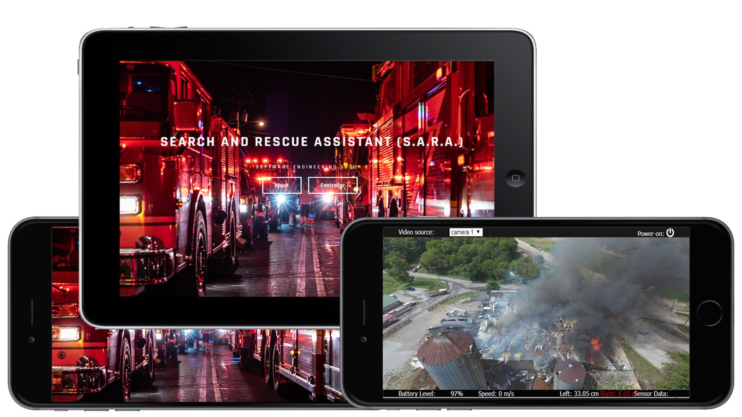
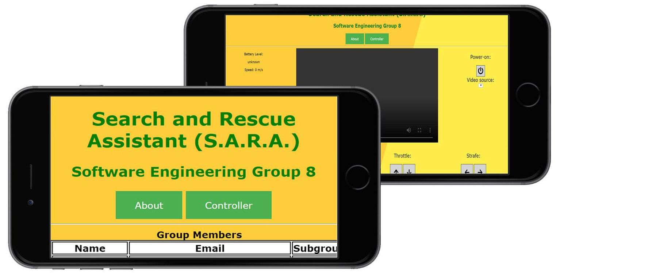
Webpage Updates
We have completely redesigned the website
Desktop and mobile friendly
We are able to track the location of the camera when it is connected to the webpage interface.
The camera is able to stream its video feed to the user on the interface
The battery status of the camera is able to be displayed on the webpage
The camera’s current position in terms of latitude and longitude is displayed
The current speed of the phone is able to be displayed on the webpage
The sensor data from two ultrasonic sensors are also on shown on the webpage

Slide 5
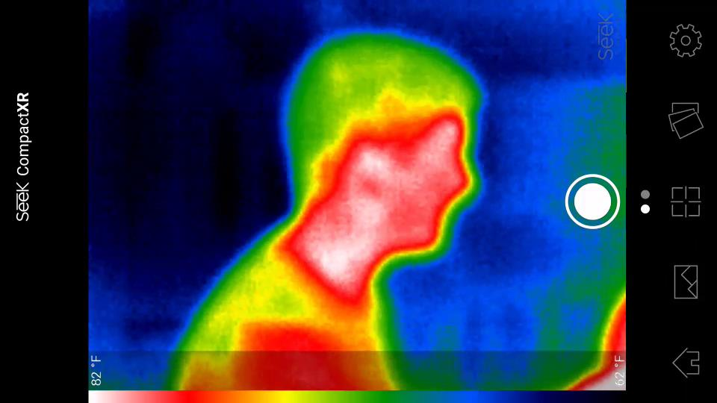
Thermal Camera
Able to locate people easier even in dark
In total darkness, it is possible to actually see objects that are in the environment besides people.
Description of camera
It is a micro usb plug in camera
The seek thermal camera is used to access the infrared features.

